Slide 1

Androgens – vital for loving and living in women over 40!
Zdravo, Dobar Dan!
Nick Panay BSc MRCOG MFSRH
Immediate Past Chairman, BMS
Co Editor in Chief Climacteric
Queen Charlotte’s & Chelsea and Chelsea & Westminster Hospital & Imperial College London
THANK YOU TO PROF SIMUNIC AND THE CROATIAN GYNAE ENDOCRINE CONGRESS ORGANISING COMMITTEE FOR THE INVITATION

Slide 2
Androgens – vital for loving and living in women over 40!
Agenda
Androgen Physiology
Androgen levels and sexual desire – who should we treat?
Pragmatic Approach to Managing HSDD (distressing low sexual desire)
Treatment Options
Safety
Advisory Bodies
Take Home Messages
Notes:
I WILL FIRST DEFINE HSDD, WHICH IS THE KEY ISSUE IN THIS PRESENTATION
AND THEN DISCUSS WHETHER ANDROGEN LEVELS ARE CORRELATED WITH LEVELS OF SEXUAL DESIRE?
I WILL THEN ADDRESS THE ISSUE OF ANDROGENS IN SURGICAL MENOPAUSE/POI, NATURAL MENOPAUSE AND IN PRE MENOPAUSAL WOMEN
…AND SUGGEST A PRAGMATIC APPROACH TO MANAGING DISTRESSING LOW SEXUAL DESIRE
FINALLY, I WILL DISCUSS THE AVAILABLE ANDROGENIC TREATMENT OPTIONS AND FINISH WITH SOME TAKE HOME MESSAGES

Slide 3
Physiology of Endogenous Androgens

Slide 4
The Role of Androgens in Female Sexual Function
Sex hormones (E, T, P) prime the CNS to respond to sexual stimulation¹⁻²
Androgen receptors exist in a number of CNS areas (hypothalamus, cortical & limbic) and are targeted in various ways by androgens
  Via the systemic circulation
  Directly from the brain (steroidogenic organ)
  By aromatisation to estrogen
1.Meston et al Arch Gen Psych 2000; 2.Studd & Panay Climacteric 2004

Slide 5
The Role of Androgens in Female Sexual Function
Androgens produced mainly by ovaries and adrenals under stimulation of LH and ACTH
Major androgens include DHEAS, DHEA, androstenedione (A) and testosterone (T)
T is the most potent androgen
DHEAS, DHEA, A are androgenic precursors to testosterone
T is converted to DHT and Estradiol

Slide 6
The Role of Androgens in Female Sexual Function
Healthy young women produce approx 100 – 400 mcg/day
  3-4 times more testosterone than oestrogen
Testosterone modulates sexual desire, arousal and orgasm
Testosterone levels also affect other aspects of female physiology
General well- being
Energy
Mood
Bone physiology
Muscle mass
Hot flushes
Burger HG. Fertil Steril 2002;77, No 4, Suppl 4:S3-S5
Mazer NA. Int J Fertil 2002;47(2):77-86
Labrie F, et al. Endocr Rev. 2003;24:152-182

Slide 7
Who should we treat? - is there correlation between testosterone levels and desire?

Slide 8
Free testosterone levels decline with age
49% reduction from 18-24yrs to 65-75yrs
n= 595 women
Davison SL et al. (2005) Journal of Clinical Endocrinology & Metabolism; 90 (7): 3847-3853
Notes:
KEY POINTS
THE AIM OF THIS STUDY WAS TO DOCUMENT THE EFFECTS OF AGE ON ANDROGEN LEVELS IN HEALTHY WOMEN
1423 NON-HEALTHCARE-SEEKING WOMEN, AGED 18–75 YR, WERE RANDOMLY RECRUITED OVER 15 MONTHS
SERUM ANDROGEN LEVELS DECLINE STEEPLY IN THE EARLY REPRODUCTIVE YEARS AND DO NOT VARY DUE TO A SPECIFIC CONSEQUENCE OF NATURAL MENOPAUSE.
Explanation of box & whisker plot :
the box represents the interquartile range, and the line in the box is the median. The whiskers extend to the upper and lower adjacent values. The upper adjacent value is defined as the largest data point less than or equal to the 75th percentile 1.5 interquartile range. The lower adjacent value is defined as the smallest data point greater than or equal to the 25th percentile 1.5 interquartile range. Outliers are any values beyond the whiskers.

Slide 9
Androgens – vital for loving and living in women over 40!
Other causes of androgen insufficiency
Surgical menopause
Early ovarian impairment
Adrenal insufficiency
Iatrogenic Treatments (oral estrogens, anti androgens, COCs, GnRHa, corticosteroids)
1. Nappi et al Men Int 2010; 2. Maclaran K & Panay N Women’s Health 2011
Notes:
THERE ARE A NUMBER OF VERY IMPORTANT CAUSES OF PROFOUND ANDROGEN DEFICIENCY
THESE INCLUDE
SURGICAL MENOPAUSE
PREMATURE OVARIAN INSUFFICIENCY (POF)
ADRENAL INSUFFICIENCY
IATROGENIC TREATMENTS – ORAL ESTROGENS RAISE SHBG LEVELS, REDUCING LEVELS OF BIOACTIVE FREE TESTOSTERONE

Slide 10
Should we reserve androgen replacement for those with proven low systemic T levels?
Correlation of sexual desire with androgen levels is controversial!
Studies showing correlation with androgen levels….
Higher levels of sexual desire at menopause transition in women with higher T levels¹
121 women with HSDD v 124 controls – DHEAS and other androgenic precursor levels significantly lower²
Lower circulating levels of E2 and DHEAS in highly symptomatic early postmenopausal women with HSDD³
1. Woods et al Seattle Midlife Women’s Health Study J Women’s Health 2010 2. Basson et al Menopause 2010
3. Nappi et al Maturitas 2010
Notes:
THE QUESTION I AM OFTEN ASKED IS SHOULD WE RESERVE ANDROGEN REPLACEMENT FOR WOMEN WITH PROVEN LOW SYSTEMIC LEVELS?
THIS IS CONTROVERSIAL; IT HAS ACTUALLY BEEN DIFFICULT TO PROVE A CAUSAL ASSOCIATION BETWEEN LOW ANDROGEN LEVELS AND LOW SEXUAL DESIRE
SOME STUDIES SUGGEST THAT THERE IS A RELATIONSHIP, SUCH AS THE FOLLOWING STUDIES READ SLIDE
OTHER STUDIES SUCH AS THE PREVIOUSLY PRESENTED AUSTRALIAN DATA HAVE NOT SHOWN A CORRELATION.

Slide 11
Should we reserve androgen replacement for those with proven low systemic T levels?
But, confounding variables make direct correlation of T with HSDD difficult
  Intensity of sexual symptoms is affected by
    estrogen deficiency symptoms (esp urogenital atrophy)
    predominantly mood related symptoms
    poor social/environmental factors: work/relationship related stress, financial concerns etc
    restrictive cultural practices¹
1. Nappi et al Maturitas 2010
Notes:
THERE ARE A NUMBER OF REASONS WHY A CAUSAL ASSOCIATION IS OFTEN NOT FOUND
THERE ARE, FOR INSTANCE, CONFOUNDING VARIABLES…
THE INTENSITY OF SEXUAL SYMPTOMS IS AFFECTED BY A NUMBER OF FACTORS
ESTROGEN DEFICIENCY SYMPTOMS (ESP URIGENITAL)
MOOD RELATED SYMPTOMS
SOCIOECONMIC AND RELATIONSHIP FACTORS
CULTURAL PRACTICES
JOHN STUDD HAS ALWAYS SAID ‘HEART, HEAD AND HORMONES!”

Slide 12
Should we reserve androgen replacement for those with proven low systemic T levels?
Brain intracrinology
May be more critical to female sexual desire and function than peripheral androgens¹⁻²
Androgenic metabolites (either within the cells of the target tissue or released into the plasma) are produced locally from precursors such as DHEA
This could be main explanation for complex correlation between circulating testosterone levels and sexual desire
1. Labrie et al Endocr Rev 2003; 2.Brotto et al J Sex Med 2010
Notes:
ONE OF THE LEAST WELL UNDERSTOOD AREAS, BUT PROBABLY CRITICAL TO UNDERSTANDING IMPACT OF ANDROGENS IN FEMALE PHYSIOLOGY IS THE ROLE OF THE BRAIN AS A HORMONE SYNTHESISING ORGAN (INTRACRINOLOGY)
THIS MAY BE MORE CRITICAL TO FEMALE SEXUAL DESIRE AND FUNCTION THAN PERIPHERAL ANDROGENS
ANDROGENS ARE PRODUCED WITHIN THE BRAIN FROM PRECURSORS SUCH AS DHEA AND BIND TO RECEPTORS WHICH ARE PREDOMINANTLY IN THE LIMBIC AREAS WHICH SUB SEVERE EMOTION
THIS NEEDS CONSIDERABLY MORE RESEARCH TO UNRAVEL!

Slide 13
Should we reserve androgen replacement for those with proven low systemic T levels?
Inter-individual variability
Every woman has her own threshold of tissue responsiveness to hormonal variations depending on several factors e.g. genetic, biological, psychological¹
1. Nappi at al MI 2010
Notes:
IT IS LIKELY THAT SOME WOMEN ARE GENETICALLY MORE SUSCEPTIBLE TO FALLING ANDROGEN LEVELS THAN OTHERS.
SOME APPEAR TO BE ABLE TO FUNCTION ENTIRELY NORMALLY WITH VERY LOW ANDROGEN LEVELS
THESE GENETIC FACTORS COULD BE INTERROGATED WITH APROPRIATE GENE PROBES
THIS WOULD ENABLE MORE ACCURATE TARGETING OF THERAPY TOWARDS THOSE THAT MIGHT BENEFIT FROM IT.

Slide 14
Impact of POI on Sexual Function
“The earlier the menopause, the more severe and complex the impact on sexuality is”
“Very few studies (three)²⁻⁴ have specifically investigated the sexual function of women with POI”
1. Graziottin A Ann N Y Acad Sci. 2010; 2. Kalantaridou et al Fertil Steril 2006; 3. van der Stege Menopause 2008; 4. de Almeida Menopause 2011
Notes:
IT IS WELL RECOGNISED THAT POI CAN HAVE A PROFOUND PSYCHOSOCIAL AND PSYCHOSEXUAL IMPACT ON YOUNG WOMEN
THIS RECENT EDITORIAL CALLS FOR MORE STUDIES TO BE PERFORMED TO LOOK AT THE IMPACT OF POI ON ANDROGENS AND SEXUALITY
ONLY THREE STUDIES HAVE BEEN PERFORMED THUS FAR AND THEY ALL SHOW A SIGNIFICANT IMPACT ON SEXUALITY COMPARED TO NORMAL CASE MATCHED CONTROLS

Slide 15
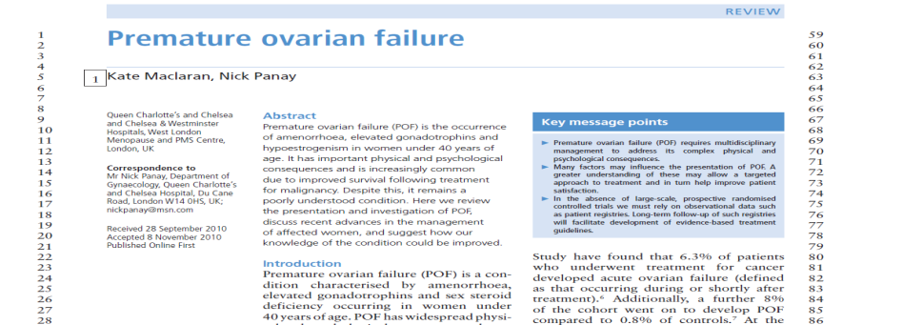
Notes:
WE HAVE A LARGE COHORT OF WOMEN WITH POI AT IMPERIAL AND C&W, >470 ON OUR DATABASE
ALMOST 50 % OF THESE WOMEN HAVE SUFFERED POI AS A RESULT OF SURGICAL / MEDICAL INTERVENTIONS FOR GYNAECOLOGICAL HAEMATOLOGICAL AND OTHER MALIGNANCIES
EFFORTS IN THE PART HAVE FOCUSSED ON IMPROVING SURVIVAL RATES OF THESE YOUNG WOMEN – WE NOW NEED TO DEDICATE SOME RESOURCES TO IMPROVING THEIR QUALITY OF LIFE
WE HAVE GIVEN THEM THE BACK THE GIFT OF LIFE – WE NOW NEED TO GIVE THEM THE ZEST TO LIVE IT TO ITS FULL
LONGEVITY MEANS NOTHING WITHOUT QUALITY OF LIFE

Slide 16
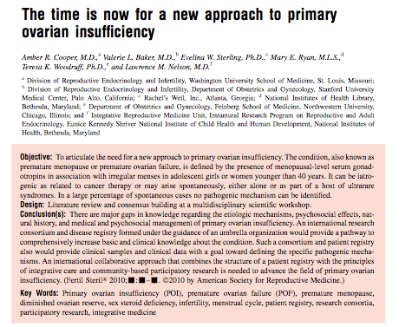
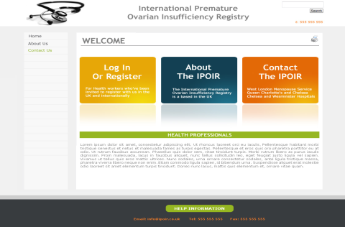
www.poiregistry.net
Database Opportunities
1)POI presentation
2)Impact of Interventions
e.g. HRT v COCP
3)Role of Biomarkers e.g. AMH
4)Bio-bank for Genetic Studies
Notes:
THERE HAS BEEN A CALL FROM OUR GROUP, AND OTHERS SUCH AS LARRY NELSON’S GROUP AT HARVARD, FOR A NEW APPROACH TO POI, AND IN PARTICULAR THE SETTING UP OF AN INTERNATIONAL REGISTRY OR DATABASE
THERE ARE NUMEROUS OPPORTUNITIES TO GLOBAL DATABASE INCLUDING CLARIFYING THE TIMECOURSE OF POI, THE LONGTERM IMPACT OF INTERVENTIONS, ROLE OF BIOMARKERS AND POSSIBLE GENETIC STUDIES

Slide 17
Premature Ovarian Insufficiency
Prevalence of FSD
HSDD was reported in 64% in our POI cohort (> 50% iatrogenic)
  Singer Mann Hunter Pitkin Panay Climacteric 2011
Impact of androgens on HSDD in women with spontaneous POI needs urgent study
  Maclaran K, Panay N Women’s Health 2011
Notes:
DISTRESSING LOW SEXUAL DESIRE WAS REPORTED BY NEARLY TWO THIRDS OF OUR POI COHORT
WE HAVE CALLED FOR URGENT RESEARCH ON THE IMPACT OF ANDROGENS IN THIS YOUNG COHORT

Slide 18
Patient concerns
%
Singer D, Mann E, Hunter M, Pitkin J, Panay N, Climacteric 2011
Notes:
DATA FROM IMPERIAL, NORTHWICK PARK AND PROVIDED BY THE DAISY NETWORK SHOW THAT
SEXUAL FUNCTION AND PSYCHOLOGICAL EFFECTS RANK HIGHLY IN PATIENT CONCERNS ABOUT POI

Slide 19
Pragmatic Approach to Managing HSDD
Notes:
I WOULD NOW LIKE TO DISCUSS A PRACTICAL APPROACH TO MANAGING DISTRESSING LOW SEXUAL DESIRE IN THE CLINIC WHICH YOU CAN HOPEFULLY ADAPT TO YOUR INDIVIDUAL PRACTICE

Slide 20
Pragmatic Approach to Managing HSDD
  Validated questionnaires – used mainly in studies e.g. FSFI or PFSF – but, you need to ask the right questions to get the right answers!
  Multidisciplinary approach with psycho sexual counsellor / psychologist to explore relationship / psychological issues
  History – medical problems e.g. thyroid, diabetes, SSRIs
  Examination – atrophic changes, prolapse, PID, endometriosis etc.
  Investigations for concomitant conditions e.g. TFTs, prolactin
1. Nappi et al Men Int 2010; 2. Maclaran K & Panay N Women’s Health 2011
Notes:
IDEALLY, VALIDATED QUESTIONNAIRES WOULD BE USED ROUTINELY
IN REALITY, THESE ARE ONLY ADMINISTERED AS PART OF RESEARCH PROGRAMMES / SERVICE EVALUATION / AUDIT
THE IMPORTANT RESOURCE (OFTEN LACKING) IS TIME TO ALLOW FOR THE CONVERSATION TO BE STEERED TOWARDS PSYCHSEXUAL ISSUES
IF YOU DON’T ASK THE QUESTION, YOU WON’T GET THE ANSWER
MULTIDISCIPLINARY TEAMS E.G. PSYCHOSEXUAL COUNSELLOR / PSYCHOLOGIST ARE PARTICULARLY VITAL IN TERTIARY CENTRES MANAGING COMPLEX PROBLEMS
EXCLUSION OF OTHER ORGANIC DISORDERS IS ESSENTIAL, PARTICULARLY THYROID DISORDERS OFTEN HAVE OVERLAPPING SYMPTOMS. USE OF SSRIS
EXAMINATION – ESP FOR ATROPHIC CHANGES WHICH MAY NEED CORRECTION WITH ESTROGEN
TESTS – ESP FOR THYROID DISORDERS, PROLACTIN ETC

Slide 21
Pragmatic Approach to Managing HSDD
Androgen Insufficiency Syndrome & HSDD diagnosis is based on symptoms, not androgen levels¹⁻²
Possible Symptoms
  Low libido, sexual receptivity, pleasure, persistent inexplicable fatigue, blunted motivation, reduced sense of wellbeing
  Reduced pubic hair, bone mass, muscle mass, reduced cognition, low mood, poor QOL, VMS, insomnia, headaches
1. Nappi et al Men Int 2010; 2. Maclaran K & Panay N Women’s Health 2011
Notes:
THE DIAGNOSIS OF ANDROGEN INSUFFICIENCY AND HSDD SHOULD BE BASED PRIMARILY ON SYMPTOMS RATHER THAN ANDROGEN LEVELS

Slide 22
Pragmatic Approach to Managing HSDD
Should we measure T levels? – there are problems……¹
Lack of consensus on “normal” lower limit for T / FT
Difficulties with assay sensitivity at lower levels
Free T assays often not available: need to calculate FAI Testosterone x 100 / SHBG ( FAI < 6.5% upper limit )
Tertiary Centre: Baseline and treatment levels at 2 – 3 months with TD testosterone, 5 – 6 months with implants
1. Maclaran K & Panay N Women’s Health 2011
Notes:
I AM OFTEN ASKED WHETHER IT IS ESSENTIAL TO MEASURE ANDROGEN LEVELS I THINK IT CAN BE USEFUL,
-POSSIBLE CORRELATION WITH LOW SEXUAL DESIRE
-TO AVOID GIVING T SUPPLEMENTS TO WOMEN WHO ALREADY HAVE HIGH LEVELS
-TO SHOW THAT WE ARE ONLY AIMING TO RAISE LEVELS WITHIN THE NORMAL PHYSIOLOGICAL RANGE (AVOIDS SIDE EFFECTS)
-CHECK LEVELS PRE TREATMENT AND AT 2-3 MONTHS INITIALLY (6 FOR IMPLANTS)
AS LONG AS WE ARE AWARE OF THE LIMITATIONS – THESE ARE…
1)THERE IS A LACK OF CONSENSUS ON WHAT CONSTITUTES THE NORMAL LOWER FEMALE LIMIT (A NUMBER OF LABS GIVE THE LOWER NORMAL VALUE AS ZERO!)
2)ROUTINE ASSAYS BECOME INSENSITIVE AT LOW LEVELS
3)FREE TESTOSTERONE ASSAYS (THE MOST ACCURATE WAY OF ESTIMATING BIOACTIVE TESTOSTERONE) ARE OFTEN NOT AVAILABLE OR AVAILABLE AT ADDITIONAL EXPENSE – A SIMPLE CALCULATION WOULD BE TESTOSTERONE TIMES 100 DIVIDED BY SHBG TO ESTIMATE FREE TESTOSTERONE FROM THE TOTAL VALUE (UPPER LIMIT 6.5%
5) IN WOMEN WITH A CYCLE THERE ARE DIURNAL VARIATIONS (HIGHEST AT NIGHT) AND CYCLICAL VARIATIONS – LEVELS ARE LOWEST IN THE EARLY FOLLICULAR PHASE AND HIGHEST IN THE PERIOVULATORY / EARLY LUTEAL PHASE
4)SHOULD WE BE MEASURING OTHER ANDROGENS SUCH AS ANDROSTENEDIONE & DHEAS (ADRENAL FATIGUE!)

Slide 23
Treatment Options
Notes:
I WOULD NOW LIKE TO DISCUSS A PRACTICAL APPROACH TO MANAGING DISTRESSING LOW SEXUAL DESIRE IN THE CLINIC WHICH YOU CAN HOPEFULLY ADAPT TO YOUR INDIVIDUAL PRACTICE

Slide 24
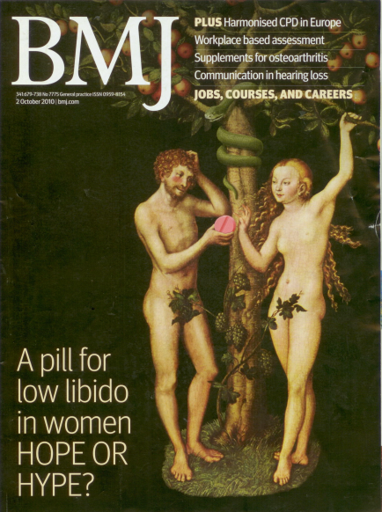
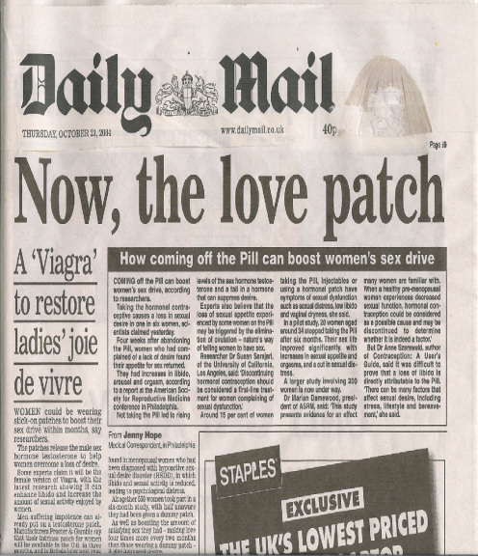
Treatment Options

Slide 25
Androgenic Options
Oral Methytestosterone – Liver Effects
Injections – High dose / androgenic / painful IM
DHEA (po / pv) – More data, phase III trials ongoing
Tibolone – Weakly androgenic 2 RCTs show benefit
Implants? – Difficult to access; not for primary care
Transdermal patches – for discussion
Gel – for discussion
Pill-Plus - (Androgen Restored Contraception) – Phase III
Is testosterone Pink Viagra!?
Notes:
THIS IS THE FULL RANGE OF ANDROGENIC OPTIONS –MOST WOULD HAVE TO BE USED OFF LABEL / OFF LICENSE
READ SLIDE

Slide 26
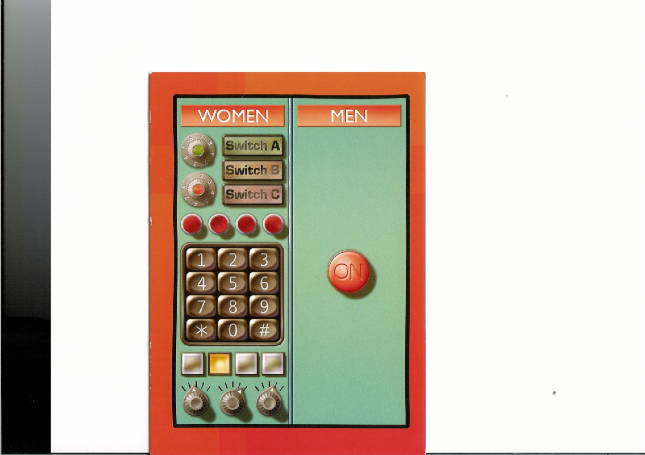
Notes:
OF COURSE NOT, WOMEN ARE MUCH MORE COMPLEX BEINGS THAN MEN WHO JUST NEED AN OFF OFF SWITCH TO BE TRIGGERED FOR THE PLUMBING TO WORK!

Slide 27
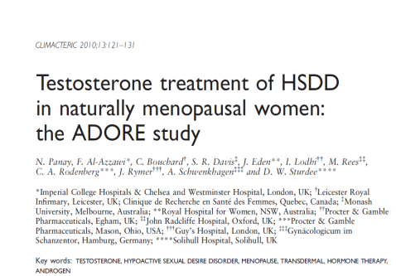
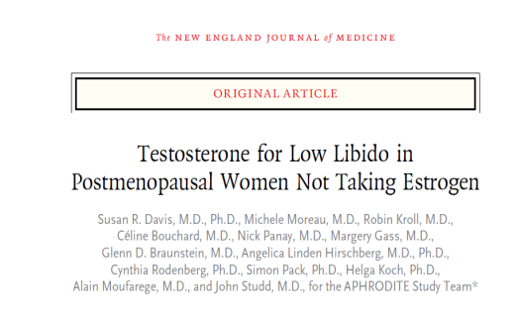
Testosterone Patches - where are we now after 10 years of research?
2012/3
Intrinsa license withdrawn by Warner Chilcott – profitability decision!
Product recently bought by HFA, marketed at £395 per month!
2013
5 year “Libigel” safety data awaiting analysis >7000 women years
Indefinite testosterone implant supply “secured” by pharmarama
Maclaran K, Panay N. Managing low sexual desire in women. Women’s Health (Lond Engl) 2011;7:571-81.
Maclaran K, Panay N. The safety of postmenopausal testosterone therapy. Women’s Health (Lond Engl) 2012;8:263-75.
Notes:
WELL, I WAS INVOLVED IN STUDIES IN SURGICAL, NATURAL MENOPAUSE AND TESTOSTERONE ALONE WITH TESTOSTERONE (INTRINSA) PATCHES WHICH CONFIRMED BENEFITS V PLACEBO (60 V 30% IMPROVEMENT IN DISTRESSING LOW SEXUAL DESIRE HSDD)
HOWEVER, THE REGULATORS DEMANDED MORE DATA BEFORE GRANTING A LICENSE FOR WOMEN WITH NATURAL MENOPAUSE / USAGE WITHOUT ESTROGEN AND THE COMPANY WITHDREW THE PRODUCT LICENSE DUE TO A PROFITABILITY DECISION
INTRINSA WAS BOUGHT BY HFA WHO HAVE PLEDGED TO CONTINUE TO SUPPLY THE PRODUCT BUT BECAUSE AS THEIR REP PUT IT, THEY ARE TAKING A FINANCIAL GAMB,E THEY ARE CHARGING NEARLY £400 PER MONTH!
MOST OF MY PATIENTS HAVE DECIDED TO SWITCH TO ALTERNATIVES SUCH AS GELS (OFF LICENSE)
BIO SANTE ARE CURRENTLY SITTING ON 7000 PATIENT YEARS OF SAFETY DATA FOR LOW DOSE TESTOSTERONE GEL DUE TO FINANCIAL PROBLEMS

Slide 28
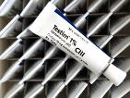
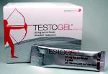

Are gels a realistic option?
Testim gel / Testogel / Tostran
  Off Label in women but useful!
  Pea sized blob (0.5-1.0ml) to abdomen daily (1 week/tube or sachet)
  1 pump every 2/3 days (Tostran)
  FAI < 7.0 (physiological female upper limit – no beards!)
Notes:
CURRENT PRACTICE
IMPLANTS – STOPPED BY MSD PROF DECISION
LIVIAL – WEAKLY ANDROGENIC
INTRINSA – STOPPED BY WARNER – PROF DECISION
USING GELS – EACH TUBE 1 WEEK LOWER ABDOMEN
FAI < 7.0

Slide 29
Still awaiting analysis!
Large 5 year US study (BLISS) of testosterone gel (Libigel) on CV and Breast Cancer risks¹
  >2800 women recruited
  No excess risk of CVD / Breast Cancer otherwise study would have been stopped by DMB but database locked with no funds remaining for analysis!
  No androgen preparations licensed by FDA to date
1.White et al Am Heart Journal Jan 2012
Notes:
THIS IS A REGISTRATION STUDY CURRENTLY UNDERWAY IN THE USA OF LIBIGEL IN WOMEN WITH HSDD
MORE THAN 2000 WOMEN WILL BE STUDIED OVER 5 YEARS – THIS SHOULD ALLOW DATA TO BE COLLECTED ON HARD OUTCOMES SUCH AS BREAST CANCER AND CVD RATHER THAN JUST RISK MARKERS

Slide 30
Pill-Plus - (Androgen Restored Contraception)
Addition of DHEA to EE/Progestogen pills
Six prospective, randomized controlled (placebo or active) Phase II clinical studies of the Pill-Plus have been completed in 355 subjects.
Increase frequency of sexual activity, arousal, responsiveness to partner, genital sensations and vaginal lubrication.
Improvements also in quality of life scores. No significant androgenic effects were noted.
Bio Sante Press Release 2012
Notes:
I AM OFTEN ASKED WHETHER IT IS ESSENTIAL TO MEASURE ANDROGEN LEVELS I THINK IT CAN BE USEFUL,
-POSSIBLE CORRELATION WITH LOW SEXUAL DESIRE
-TO AVOID GIVING T SUPPLEMENTS TO WOMEN WHO ALREADY HAVE HIGH LEVELS
-TO SHOW THAT WE ARE ONLY AIMING TO RAISE LEVELS WITHIN THE NORMAL PHYSIOLOGICAL RANGE (AVOIDS SIDE EFFECTS)
-CHECK LEVELS PRE TREATMENT AND AT 2-3 MONTHS INITIALLY (6 FOR IMPLANTS)
AS LONG AS WE ARE AWARE OF THE LIMITATIONS – THESE ARE…
1)THERE IS A LACK OF CONSENSUS ON WHAT CONSTITUTES THE NORMAL LOWER FEMALE LIMIT (A NUMBER OF LABS GIVE THE LOWER NORMAL VALUE AS ZERO!)
2)ROUTINE ASSAYS BECOME INSENSITIVE AT LOW LEVELS
3)FREE TESTOSTERONE ASSAYS (THE MOST ACCURATE WAY OF ESTIMATING BIOACTIVE TESTOSTERONE) ARE OFTEN NOT AVAILABLE OR AVAILABLE AT ADDITIONAL EXPENSE – A SIMPLE CALCULATION WOULD BE TESTOSTERONE TIMES 100 DIVIDED BY SHBG TO ESTIMATE FREE TESTOSTERONE FROM THE TOTAL VALUE (UPPER LIMIT 6.5%
5) IN WOMEN WITH A CYCLE THERE ARE DIURNAL VARIATIONS (HIGHEST AT NIGHT) AND CYCLICAL VARIATIONS – LEVELS ARE LOWEST IN THE EARLY FOLLICULAR PHASE AND HIGHEST IN THE PERIOVULATORY / EARLY LUTEAL PHASE
4)SHOULD WE BE MEASURING OTHER ANDROGENS SUCH AS ANDROSTENEDIONE & DHEAS (ADRENAL FATIGUE!)

Slide 31
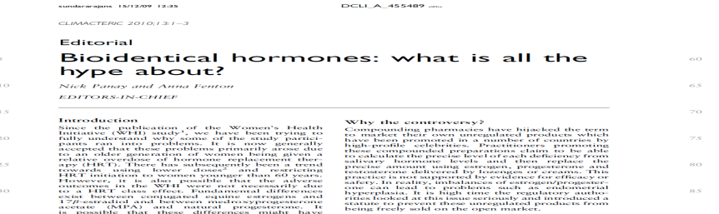
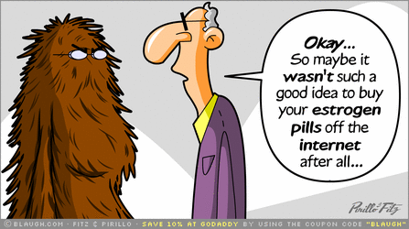
“Compounded Bio-identical Hormones”
US Senate is drafting a bill on BI hormones for 2013
“NAMS members are concerned about pharmacy compounders who operate as manufacturers without following Good Manufacturing Practices”
Notes:
UNREGULATED HORMONE THERAPY MADE UP BY COMPOUNDING PHARMACIES IS GAINING IN POPULARITY DUE TO THE LACK OF CONFIDENCE IN USING TRADITIONAL HRT
MOST OF THESE PREPARATIONS ARE IMPORTED FROM THE USA AND AUSTRALIA AND HAVE DOUBTFUL EFFICACY – MORE WORRYINGLY, SOME HAVE INADEQUATE PROGESTOGEN RELATIVE TO ESTROGEN WHICH LEADS TO BLEEDING PROBLEMS AND POTENTIALLY ENDOMETRIAL PROBLEMS

Slide 32
Safety
Notes:
I WOULD NOW LIKE TO DISCUSS A PRACTICAL APPROACH TO MANAGING DISTRESSING LOW SEXUAL DESIRE IN THE CLINIC WHICH YOU CAN HOPEFULLY ADAPT TO YOUR INDIVIDUAL PRACTICE

Slide 33
Safety Issues
AEs
  Few AEs (e.g. acne, hair growth, scalp hair loss, voice deepening etc) if physiological doses used
Endometrium
  Endometrium atrophic with unopposed T usage
Breast
  Not proliferative on epithelial cells : short term reassuring, long term clinical data required
Maclaran K Panay N Women’s Health 2012
Notes:
ENDOMETRIAL BIOPSIES AFTER ONE YEAR OF TESTOSTERONE ALONE (NO ESTROGEN/PROGESTOGEN) USAGE SHOWED NO PROLIFERATION / HYPERPLASIA (EVEN IN WOMEN WITH SPOTTING)
ORAL TESTOSTERONE CAN PRODUCE LIPID CHANGES, OTHERWISE THE IMPACT IS NEUTRAL ON THE CARDIOVASCULAR SYSTEM
CONTROVERSY EXISTS REGARDING THE POSSIBLE IMPACT ON THE BREAST – ESP AS SOME TESTOSTERONE IS AROMATISED TO ESTROGEN
SHORT TERM RCTS ARE REASSURING BUT LONGER STUDIES HAVE BEEN REQUESTED BY THE FDA BFORE THEY WILL AGREE TO LICENSE TESTOSTERONE FOR USE IN WOMEN IN THE USA

Slide 34
Cardiovascular effects of androgens
High dose non oral or oral testosterone has been associated with some adverse CV markers
    (increased visceral fat deposition, decreased HDL)
Few data have investigated the effect of physiological replacement with transdermal preparations
Recent RCTs using TTP for reduced libido noted no short term (up to 1 year) increased risk of CVD but did not include hard clinical outcomes or sensitive risk markers.
¹van Kesteren, 1997

Slide 35
Safety and tolerability of testosterone patch therapy for up to 4 years – IM 1 & 2 trials with open label extension
976 patients, 1092 patient years of exposure to 300mcg TTP
No significant effect on:
  BP, TGs, Chol, LPs, IR, LFTs
  No Excess of AEs or SAEs
Breast Cancer – consistent with age-appropriate expected rates 3 invasive breast cancers observed
Nachtigall et al Gyne Endocrinology 2011
Notes:
Lab analyses including liver function, hematology, carbohydrate metabolism, lipids and clotting parameters demonstrated no clinically relevant changes through 3 years TTP exposure.
Although not statistically significant, a small increase (<2mmHg) in blood pressure was observed.
A small significant weight gain of 1.7 kg (p<0.05, linear trend over time) was observed.

Slide 36



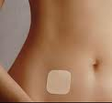
Investigating the Cardiovascular effects of the testosterone patch
Maclaran K, Panay N, Stevenson J, Collins P
Aims:
To validate a protocol designed to determine the effects of postmenopausal transdermal testosterone with HRT on:
  Cardiovascular system by assessing insulin resistance, endothelial function and arterial compliance
  Libido by assessing sexual functioning.
Hypotheses
  Transdermal testosterone, in conjunction with HRT, will not have any adverse effects on insulin resistance and vascular endothelial function in postmenopausal women.
  Transdermal testosterone significantly improves sexuality and psychological well-being in postmenopausal women.

Slide 37
Summary of Study
Significant increases in total testosterone and free androgen index
Significant increase in sexual desire as measured by B-PFSF
Significant reduction in hip circumference
No change in key cardiovascular risk markers
  arterial stiffness (Augmentation index (AIx))
  endothelial function Reactive Hyperemia Index (RHI) by Peripheral Arterial Tonometry (PAT),
  insulin resistance (Homa IR)

Slide 38
Advisory Bodies
Notes:
I WOULD NOW LIKE TO DISCUSS A PRACTICAL APPROACH TO MANAGING DISTRESSING LOW SEXUAL DESIRE IN THE CLINIC WHICH YOU CAN HOPEFULLY ADAPT TO YOUR INDIVIDUAL PRACTICE

Slide 39

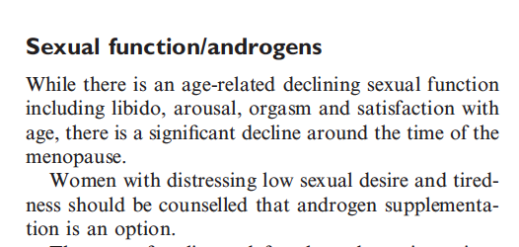
Notes:
THESE ARE THE KEY POINTS ARISING FROM THE BMS/WHC RECOMMENDATIONS ON HRT WHICH HAVE BEEN LAUCHED TODAY

Slide 40
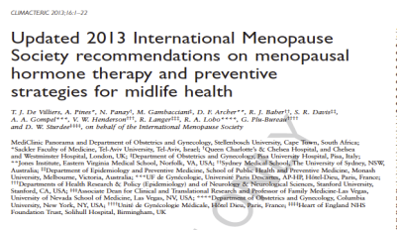
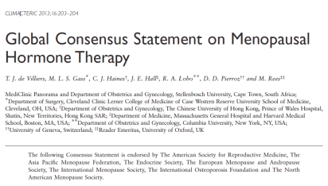

IMS Recommendations 2013:
Testosterone Susan Davis
Androgenic side effects with testosterone therapy are dose related and avoidable.
There is no evidence from large placebo controlled RCTs that transdermal testosterone in appropriate doses for women results in adverse metabolic or endometrial effects

Slide 41
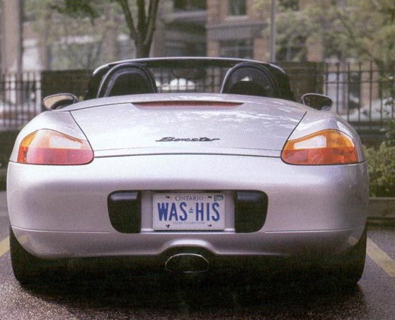
Alternative HRT – Husband replacement therapy!
Notes:
I AM OFTEN ASKED IF THERE IS ARE ANY ALTERNATIVES TO HRT FOR MANAGING HSDD
WELL, THIS IS IT (THIS SLIDE IS COURTESY OF JOHN STUDD)
HUSBAND REPLACEMENT THERAPY (THE MENOPORSCHE!)
THE MENOPORSHE!

Slide 42
Take Home Messages

Slide 43
Androgens – vital for loving and living?
Androgens physiologically modulate sexual “responsiveness” of the CNS
Testosterone levels decline with age and particularly after surgical menopause
Controversy continues regarding the precise correlation of low androgen levels with low sexual desire in women
Low sexual desire is a key symptom of both surgical & natural menopause if enquired about
Notes:
SO ARE ANDROGENS VITAL FOR LOVING AND LIVING?
WELL, THERE IS GOOD EVIDENCE THAT THEY MODULATE SEXUAL RESPONSIVENESS IN WOMEN PHYSIOLOGICALLY
LEVELS DO DECLINE WITH AGE, AND PARTICULAR AFTER SURGICAL MENOPAUSE
BUT
CONTROVERSY CONTINUES REGARDING THE PRECISE CORRELATION WITH LEVELS – PROBALY DUE TO CONFOUNDING FACTORS AND THE INTRACRINOLOGY OF THE BRAIN
PROBLEMS WITH LOW SEXUAL DESIRE ARE NOT USUALLY VOLUNTEERED, THEY HAVE TO BE SENISTIVELY ENQUIRED ABOUT

Slide 44
Androgens – vital for loving and living?
Evidence for efficacy and safety of transdermal testosterone in menopausal women
Transdermal testosterone no longer licensed in Europe for HSDD in surgical menopause but can still be prescribed “off label” by experts
We urgently need licensed options to achieve appropriate prescribing, especially in primary care
Notes:
THERE IS GOOD EVIDENCE FROM RCTS THAT TESTOSTERONE IMPLANTS, LIVIAL, PATCHES AND GELS ARE SUPERIOR TO PLACEBO FOR LOW SEXUAL DESIRE
LONG TERM DATA IN LARGER POPULATIONS WOULD BE DESIRABLE TO CONFIRM SAFETY
IT IS REASONABLE THAT OFF LABEL INITIATION OF THERAPY SHOULD BE CONFINED TO SPECIALISTS THOUGH IT SHOULD BE POSSIBLE TO COORDINATE LONG TERM MAINTENANCE WITH PRIMARY CARE
MORE LICENSED OPTIONS WOULD BE DESIRABLE TO ENCOURAGE WIDER USE OF ANDROGENS

Slide 45

Androgens – vital for loving and living?
“There is no doubt that endogenous androgens are vital for loving and living”
“Every woman should be given the opportunity to use exogenous androgens, if clinically indicated”
www.nickpanay.com
Notes:
MY OVER RIDING VIEWS ON THE SUBJECT ARE AS FOLLOWS…..

Slide 46

HVALA! Thank you for your attention and your invitation to your beautiful country! www.nickpanay.com nickpanay@msn.com

